Slide 1
Assignment 6

Slide 2
Model structure
model {
for (i in 1:N_data) {
log_reaction_time[i] ~ normal(theta[subjects[i]], sigma);
}
for (i in 1:N_subjects) {
theta[i] ~ normal(mu + phi * is_child[i], tau);
}
}
generated quantities {
real<lower = 0> mu_exp = exp(mu + tau^2/2 + sigma^2/2);
vector<lower = 0>[N_subjects] theta_exp;
real<lower = 0> reaction_time_ppc_unknown;
real<lower = 0> reaction_time_ppc_child;
real<lower = 0> reaction_time_ppc_adult;
for (j in 1:N_subjects) {
theta_exp[j] = exp(theta[j] + sigma^2/2);
}
// PPC
if (uniform_rng(0.0, 1.0) > child_proportion) {
reaction_time_ppc_unknown = exp(normal_rng(normal_rng(mu, tau), sigma));
} else {
reaction_time_ppc_unknown = exp(normal_rng(normal_rng(mu + phi, tau), sigma));
}
reaction_time_ppc_adult = exp(normal_rng(normal_rng(mu, tau), sigma));
reaction_time_ppc_child = exp(normal_rng(normal_rng(mu + phi, tau), sigma));
}
data {
int<lower = 0> N_data;
vector[N_data] reaction_time;
int<lower = 0> N_subjects;
int subjects[N_data];
int is_child[N_subjects];
real<lower = 0, upper = 1> child_proportion;
}
transformed data {
vector[N_data] log_reaction_time = log(reaction_time);
}
parameters {
// Group level
real<lower = 0> mu;
real<lower = 0> tau;
real phi;
// Individual level
vector<lower = 0>[N_subjects] theta;
real<lower = 0> sigma;
}

Slide 3
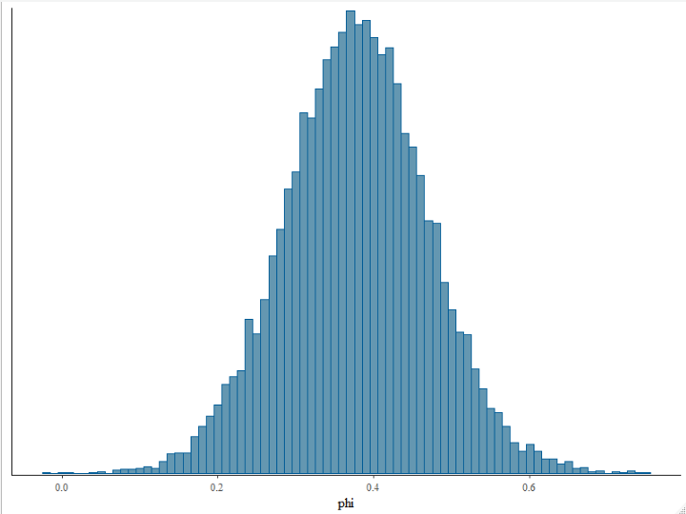
1. Do the two groups (i.e. adults and kids) have different log(reaction times) and if so what is the effect? (provide posterior point and interval estimates (mean, hdi, etc.))
mean(samples_A6$phi)
[1] 0.3776324
> hdi(samples_A6$phi, ci = 0.95)
# Highest Density Interval
95% HDI
[0.20, 0.56]

Slide 4
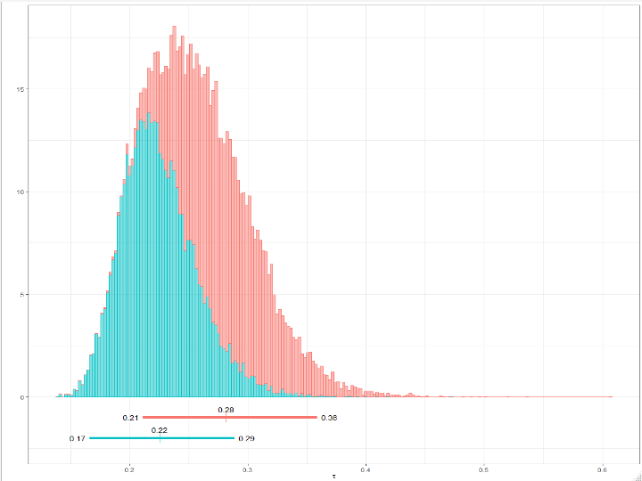
1. Posterior of tau is different compared to the previous case of using no indicator for kids and adults (i.e. Assignment 5). a) Provide plots and estimates (mean, hdi, etc.) of tau in both cases (i.e. Assignment 5 and 6) b) Why are they different? c) What does this mean in terms of shrinkage?
In assignment 5, we didn’t consider that adults and children would have different reaction times. Therefore, the tau, which is the group level standard deviation of the reaction time had to be broad enough to accomodate that.
In assignment 6, this was decoupled and the standard deviation became more narrow as the difference between adults and children is now included in ϕ

Slide 5
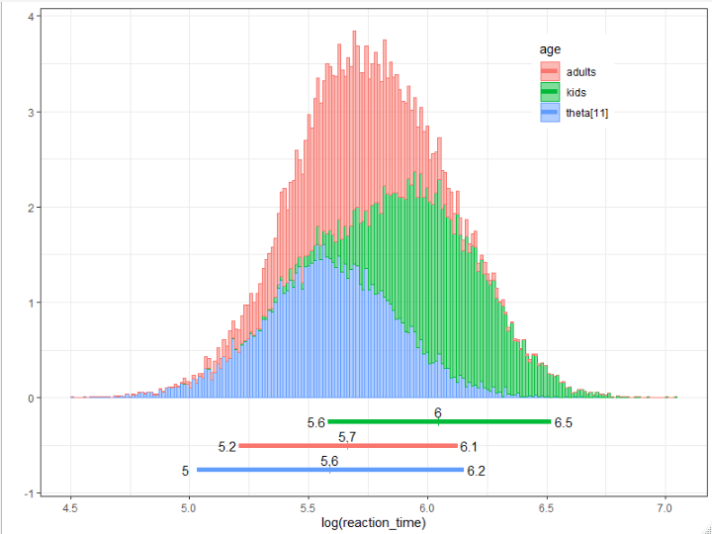
3. Plot the two prior distributions for the expected log(reaction time), one for kids and one for adults (i.e. prior for theta in Gelman’s approach and prior for (theta+phi*child) in Kruschke’s approach when child = 0,1). Compare against a single prior of theta in Assignment 5. When plotting the prior you may plot it using the mean value of its dependent parameters.
a) Explain what you see and can you give an explanation to why the curves look like they do?
Skall vara clean distributions, inte random samples,
Kan göra en line för varje mcmc chain step
Dnorm()
N <- 1e4
kids <- rnorm(n = N, mean = samples_A6$mu + samples_A6$phi, sd = samples_A6$tau)
adults <- rnorm(n = N, mean = samples_A6$mu, sd = samples_A6$tau)
theta_11 <- rnorm(n = N, mean = samples_A5$theta[,11], sd = samples_A5$tau)

Slide 6
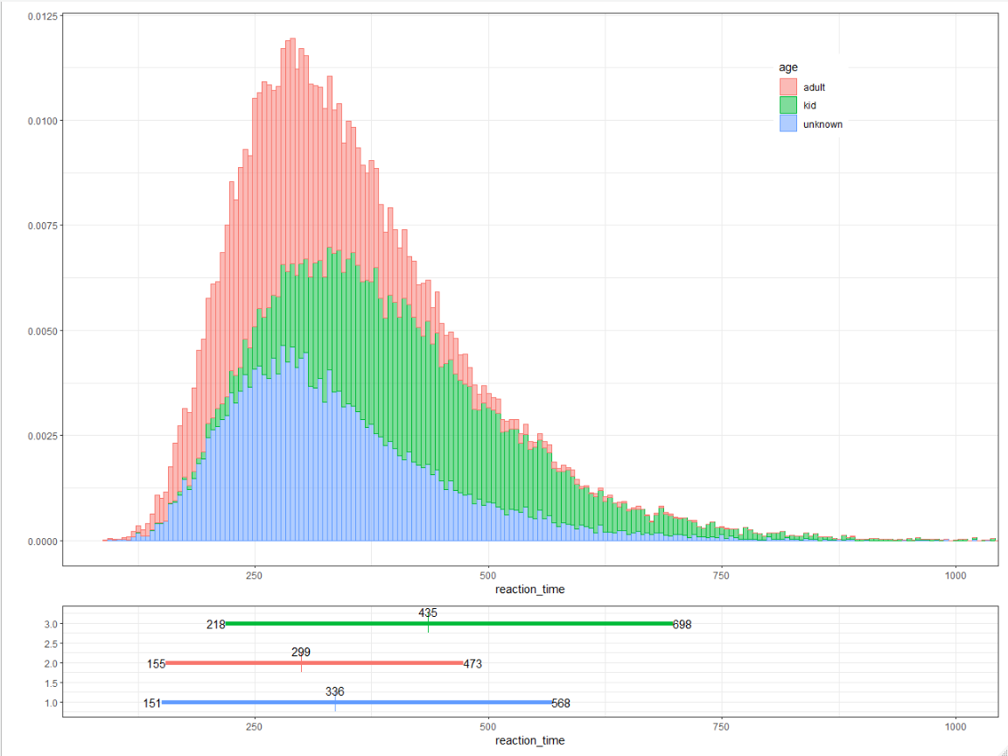
4. Provide posterior predictive distribution with knowledge of if the individual is a child and one without knowledge of if it is a child.

